Slide 1
HEALTH INSURANCE COST PREDICTION
Objective: To create a model that predicts the cost of an individual's insurance.

Slide 2
DATA SUPPLIED
There is a CSV data file which contains 7 features out of which Charges is the target feature:
1. Age
2. Sex
3. BMI
4. Children
5. Smoker
6. Region
7. Charges

Slide 3
Software languages and libraries used
Python programming language
Google colab for a notebook environment
Pandas
NumPy
Scikit-learn
Seaborn
matplotlib

Slide 4
Steps taken for this project
Part 1: Defined the problem
Outlined what are the features, the target variable?
Is it a regression problem or classification? Then decided the metric to optimize.
Part 2: Discovered the data
Checked missing, duplicate data, and outliers and summarized the data.
Visualized the features with the target to check their impact and relationship.

Slide 5
Cont…
Part 3: Developed the model
Built linear regression, support vector regressor, gradient boosting, and random forest regression model.
Fine-tuned them by hand, and fit them, selected the best one, fit and checked the prediction.
Part 4: Deployed the model on a web-app
Dumped the final model using Joblib library from Python and created app.py, html, css, JavaScript, requirements.txt, and app.yaml files.
Deployed the entire model on Google Cloud Platform App Engine to predict the insurance cost for any new prediction.

Slide 6
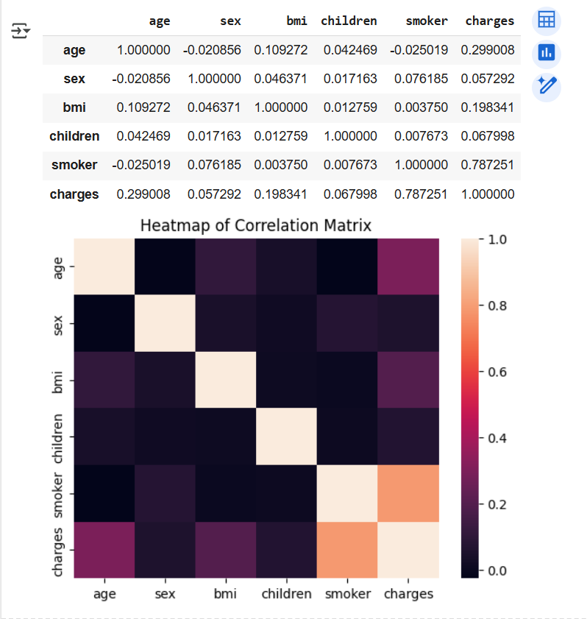
Chart shows that Smoker has the highest correlation with Charges

Slide 7
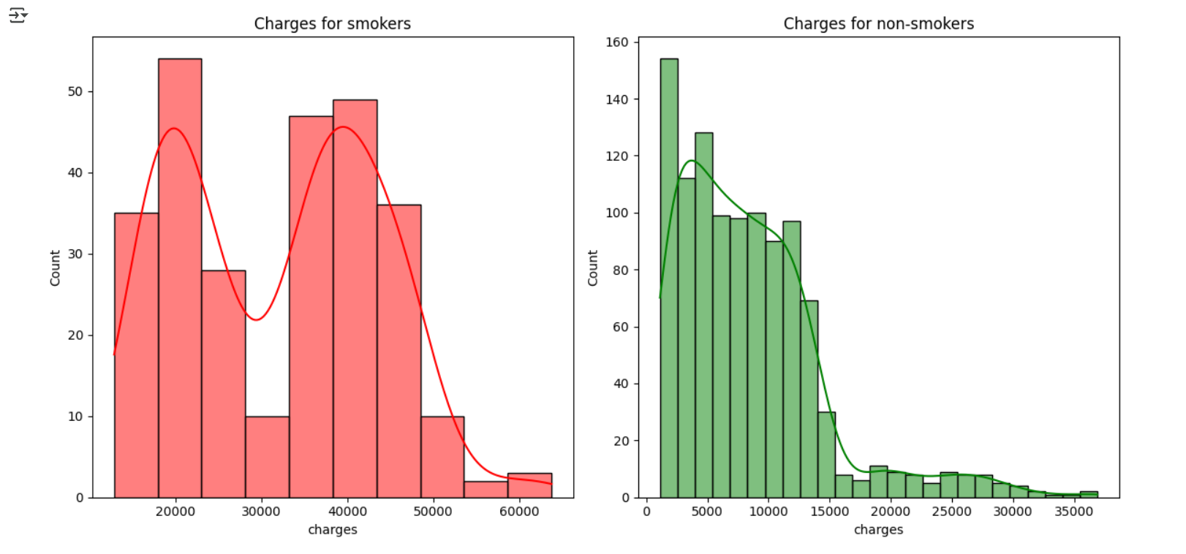
Charges for Smokers are higher than Charges for Non-smokers

Slide 8
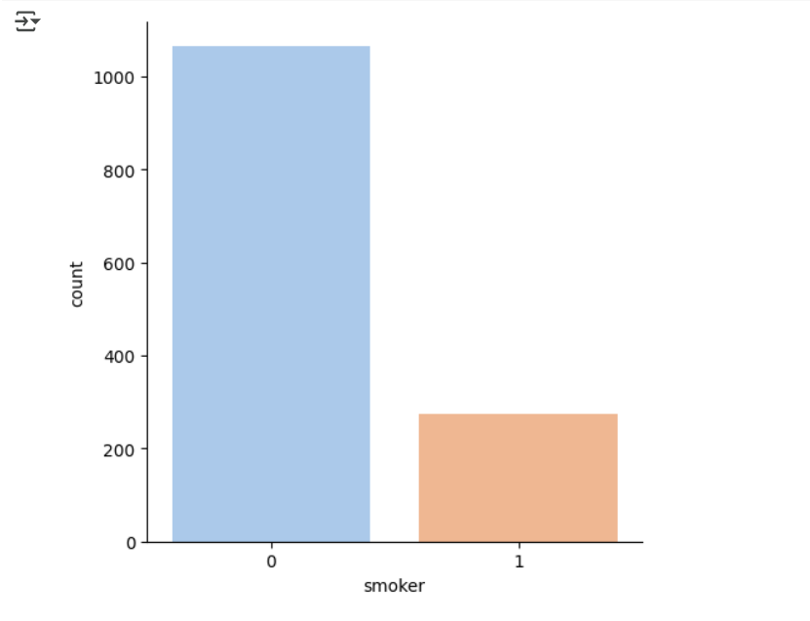
Non-smokers are higher than the smokers

Slide 9
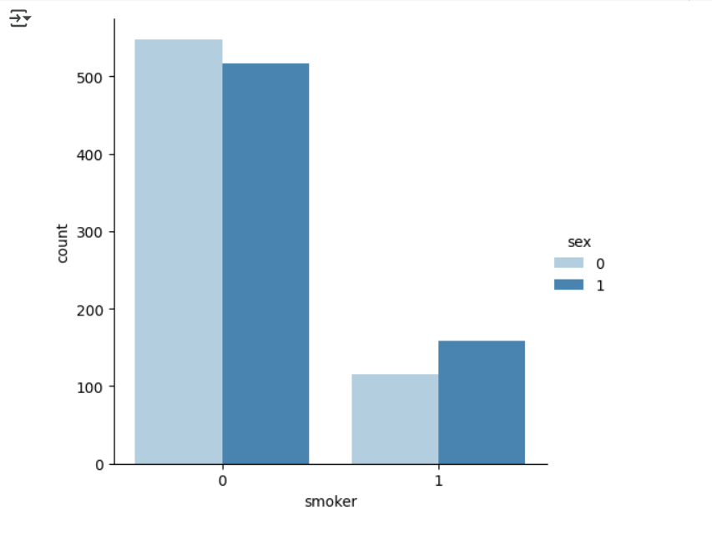
The chart shows the distribution of the smokers or non-smokers by Sex

Slide 10
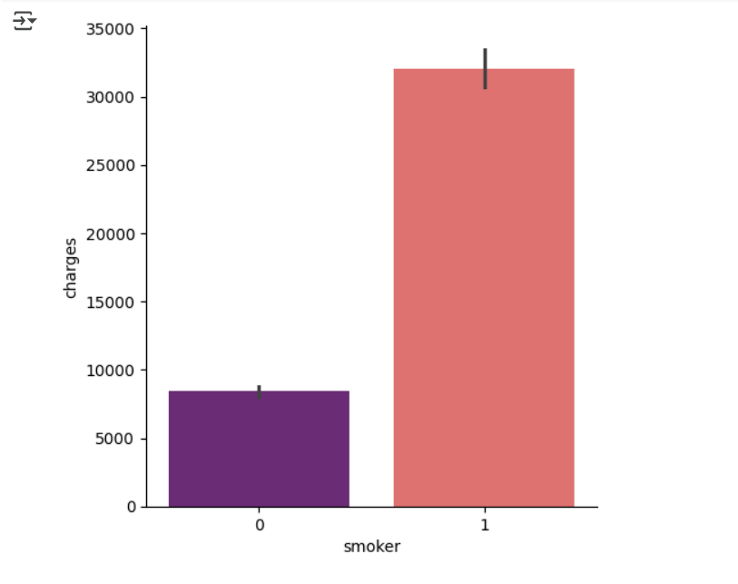
Charges are higher for Smokers compared to Non-smokers

Slide 11
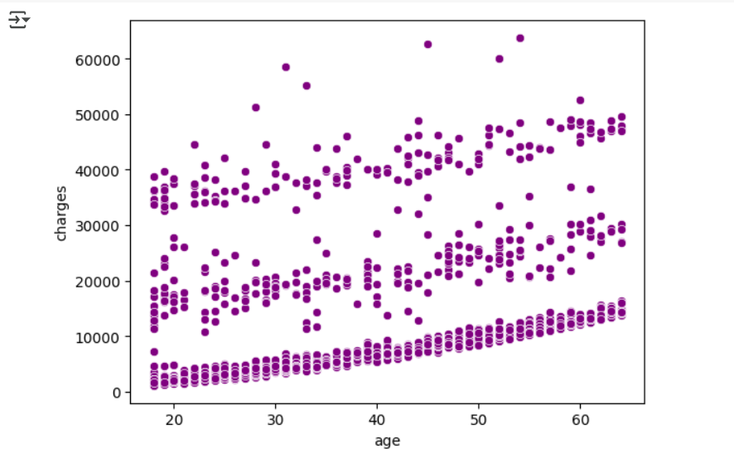
As the Age increases, Charges also increase.

Slide 12
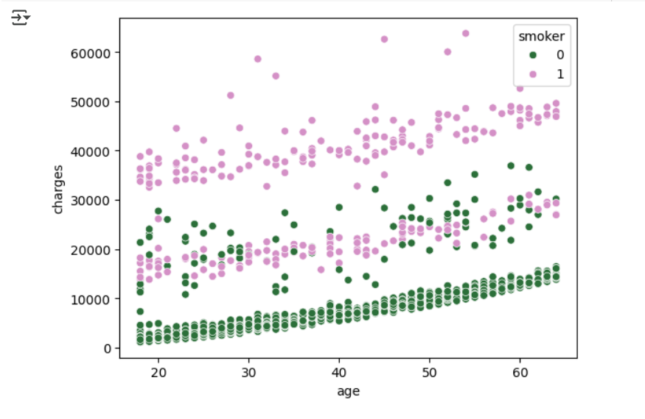
But if you smoke, then you pay high charges even if you are younger.

Slide 13
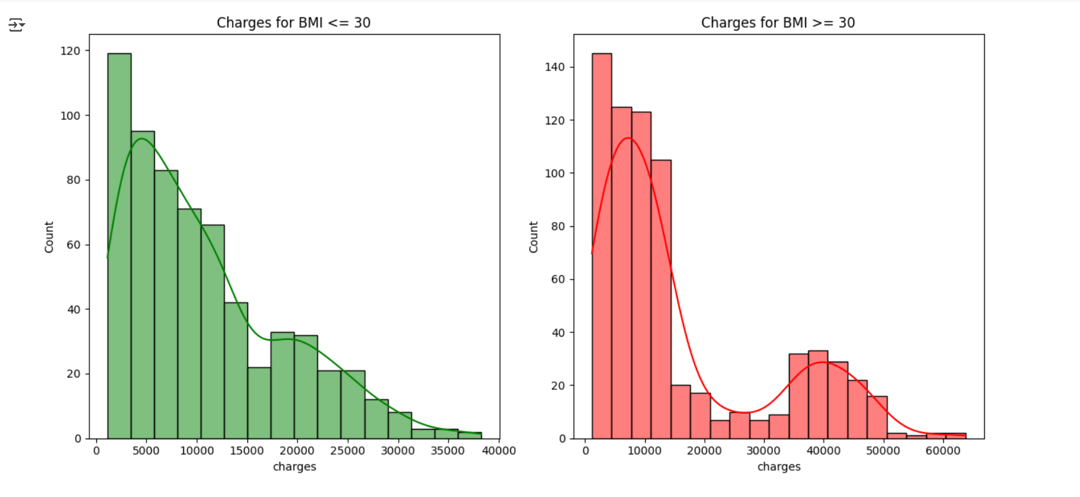
Generally, lower BMI means lower charges

Slide 14
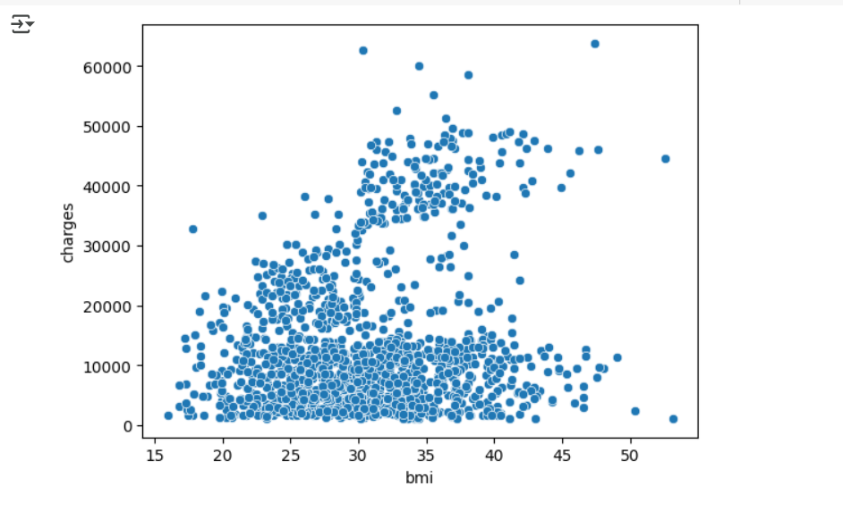
BMI does not have clear linear relationship with charges

Slide 15
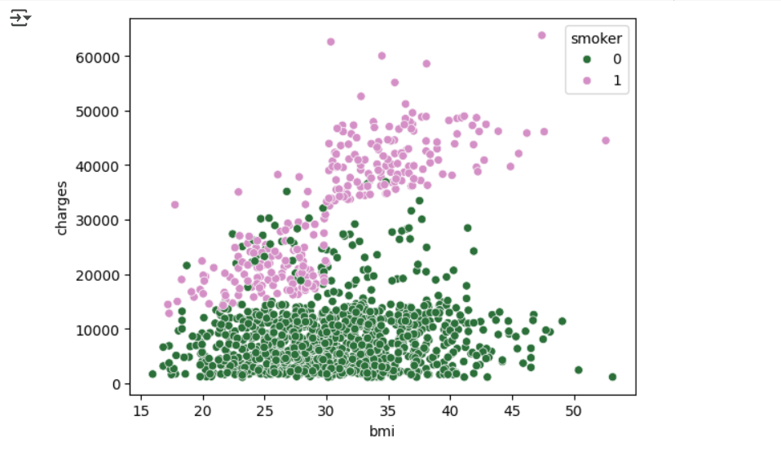
But those who smoke pay high despite having lower BMI

Slide 16
Best Model Parameters: GBM

Slide 17
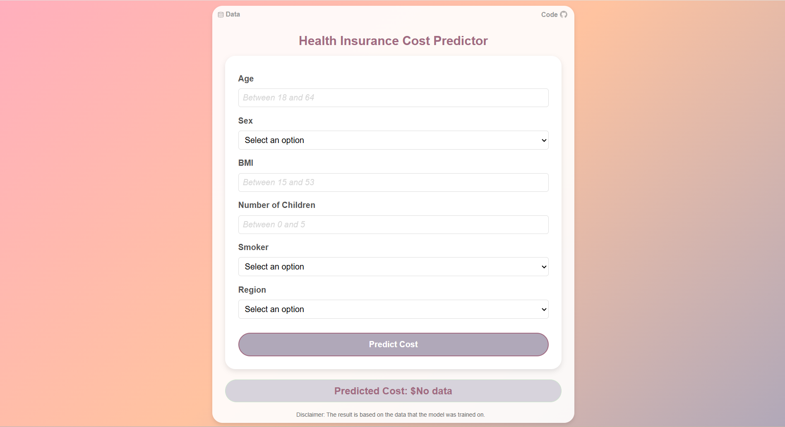
Web-App: https://insurance-cost-prediction-app.nn.r.appspot.com/

